Slide 1
Image Compression

Slide 2
Problem description
Problem description: In the computer, the gray value sequence {p₁,p₂,……p_{n}} represents the image. The integer p_{i},1<=i<=n, represents the gray value of pixel i.
Usually, the gray value ranges from 0 to 255. So at most 8 bits (2⁸) are needed to represent a pixel. If there are n gray sequences, the occupied space is 8*n.

Slide 3
Problem analysis
Analysis: Not all pixels need to be stored with binary 8 bits, because some gray values are not as large as 255, so can the algorithm be improved?
23，17，28，23，27，29，30，18，28，27，39，48，129 ，139，178，220，23，9，183，133，19，255.... We can think of 23,17,28,23,27,29,30,18,28,27 as a group (10 numbers), each of which can be stored with 5 bits (2⁵ );
{6,5,7,5,245,180,28,28,19, 22, 25,20} This is a set of gray value sequence, a total of 12 numbers, the traditional storage method: 12*8=96 bits to represent.

Slide 4
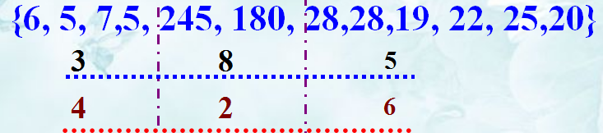
Problem analysis
If divided into three groups:
The first set has 4 numbers, the maximum is 7, so it's represented by 3 bits;
The second set has 2 numbers, the maximum is 245, so it's represented by 8 bits;
The third set has 6 numbers, the maximum is 28, so it's represented by 5 bits;
The final number of bits is 4*3+2*8+6*5+11*3=91.

Slide 5
Problem analysis
Gray value sequence P={10,12,15,255,1,2,1,1,2,2,1,1}. (12 numbers)
Method1：S1= {10, 12, 15}，S2={255}, S3={1, 2, 1, 1, 2, 2, 1, 1}。
Method2：S1={10,12,15,255,1,2,1,1,2,2,1,1}。
Method3：Divide into 12 groups, one number for each group.
Storage space
Method1：11×3+4×3+ 8×1+2×8 = 69
Method2：11×1+8×12 =107
Method3：11×12+4×3+8×1+1×5+2×3=163

Slide 6
Problem analysis
The principle of compression is to set a break point for the sequence {p₁,p₂,……p_{n}} and divide it into segments, and the pixels in the same segment occupy the same number of bits.
The process of segmentation is to find a break point so that the maximum gray value of the pixels in a segment is small, so that the segment of pixels (which would otherwise need 8 bits) can be represented by fewer bits (such as 5 bits), thus reducing storage space.

Slide 7
Problem analysis
Each pixel stores the required information:
1. The number of pixels contained in each segment of pixel; (To give a constraint, generally set no more than 256)
2. The number of bits occupied by the largest pixel in this segment of pixels;

Slide 8
Problem analysis
The problem of image compression is to determine the optimal segmentation of the pixel sequence {p₁,p₂,……p_{n}}, which minimizes the storage space required for the segmentation.
Modeling: A sequence of n pixels {p1,p2,……,pn}, divided into m segments s1,s2,……,sm, the number of pixels in the same segment occupy same bits.
S1
S2
S3
S4
Sm

Slide 9
Problem analysis
Let the t-th segment have l[t] pixels, each occupying b[t] bits.
The head of segment：It takes 11 to record l[t](8 bits) and b[t](3 bits).
In effect, the storage space is opened up to record the number of pixels (2⁸) and the number of bits of the maximum pixel in each segment (2³).
Specific pixel information: Number of pixels * number of pixels occupied by the largest pixel;

Slide 10
Problem analysis
段头
具体像素信息
段头：像素个数，约束不超过256个，采用最多8位就可存储；每个像素最多8位存储，段头用3位表示。
Total bits
Each segment

Slide 11
Dynamic programming
Ⅰ. Optimal substructure properties
Let l[i],b[i],1<=i<=m are one optimal segment of {p₁,p₂,……p_{n}}，then l[1],b[1] are one optimal segment of {p₁,……,p_{l[1]}}，and l[i],b[i],2<=i<=m are one optimal segment of {p_{l[1]+1},……,p_{n}}.

Slide 12
Ⅱ. Compute the optimal value recursively
Let s[i],1<=i<=n be the number of memory bits required for optimal segmentation of pixel sequence {p1,p1,……pi}, then s[i] is the first i-k bits plus the last k bits of storage space.

Slide 13
Ⅱ. Compute the optimal value recursively
From the optimal substructure properties:
K indicates the disconnection position
P1, P2, …. P_{i-k} P_{i-k+1}, P_{i-k+2}, ….. P_{i}

Slide 14
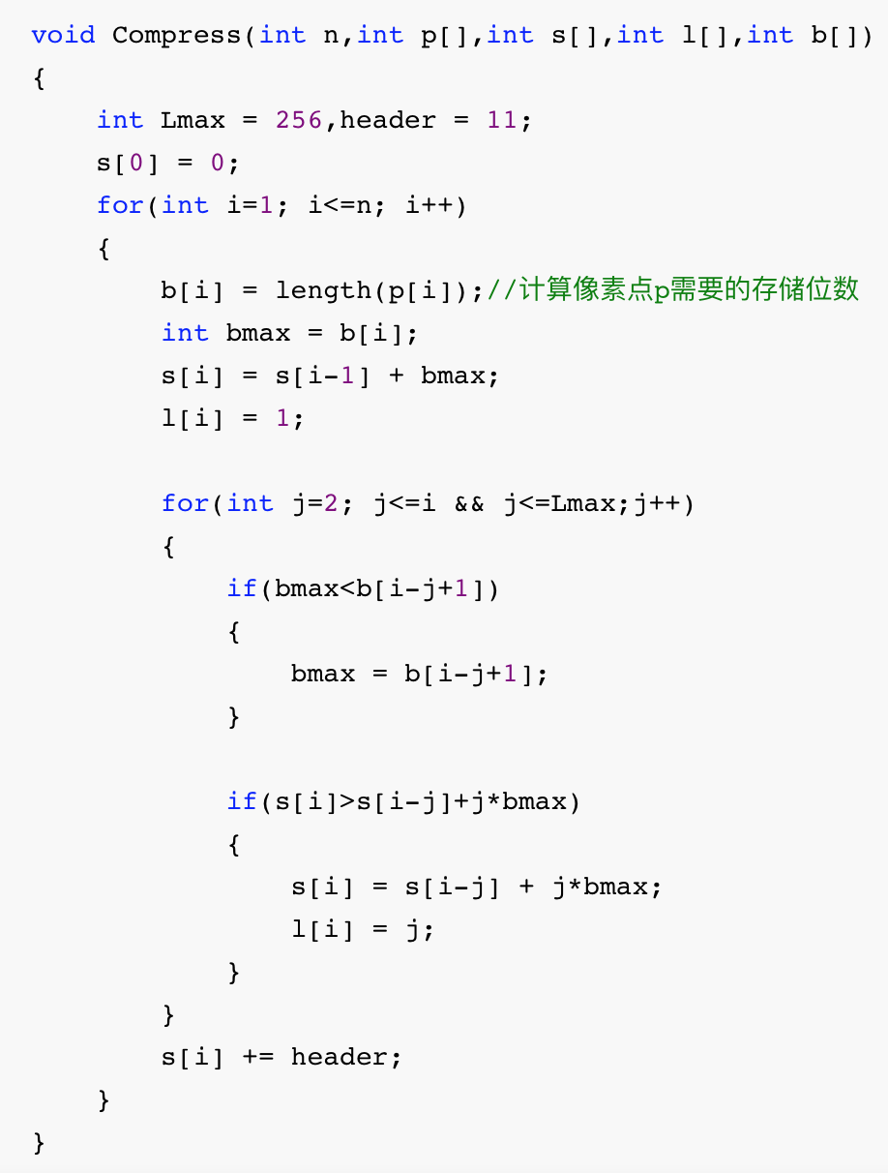
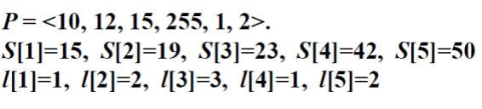
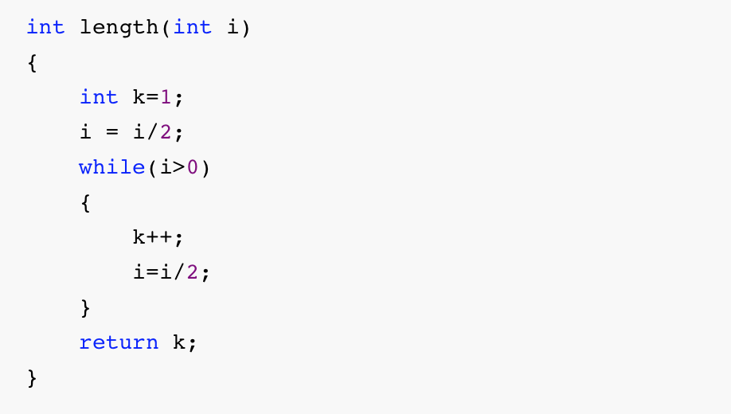

Slide 15
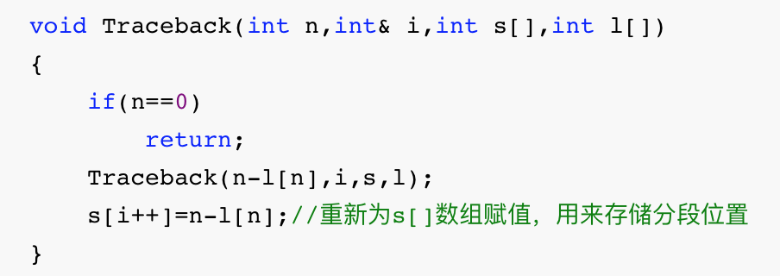
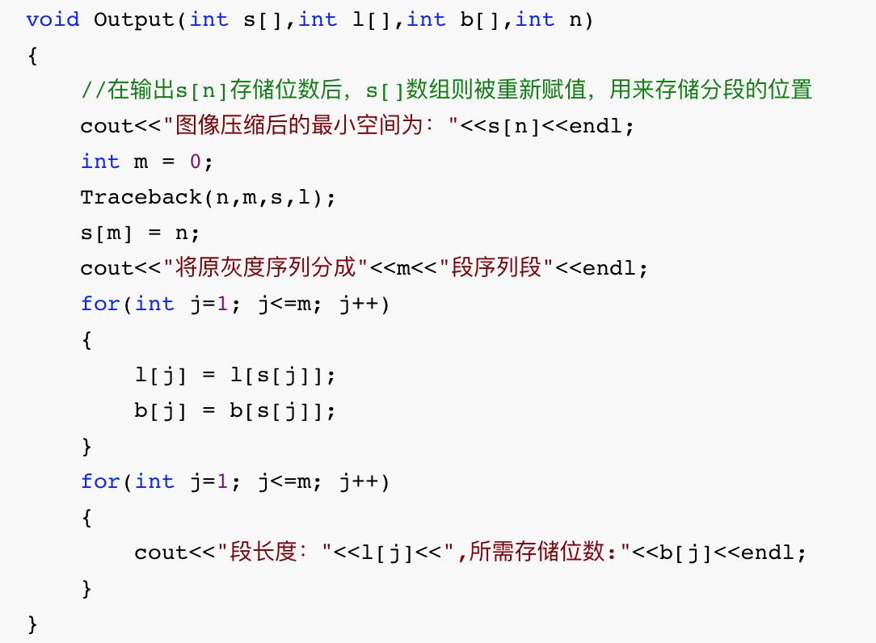
 | l[n] | b[n] | s[n]
1 | 1 | 4 | 15
2 | 2 | 4 | 19
3 | 3 | 4 | 23
4 | 1 | 8 | 42
5 | 2 | 2 | 50
6 | 2 | 2 | 57
 | s[n]
0 | 0
1 | 3
2 | 4
3 | 6
l[1]=l[s[1]]=l[3]=3 | l[2]=l[s[2]]=l[4]=1 | l[3]=l[s[3]]=l[6]=2
b[1]=b[s[1]]=b[3]=4 | b[2]=b[s[2]]=b[4]=8 | b[3]=b[s[3]]=b[6]=2

Slide 16
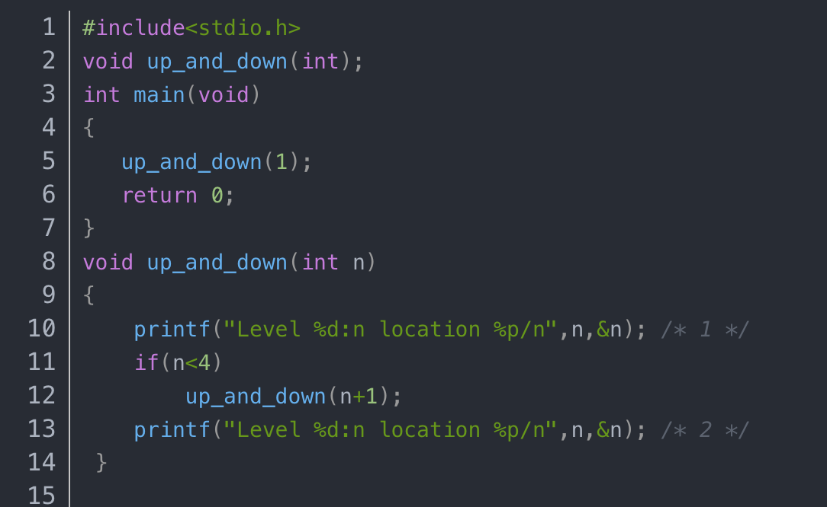
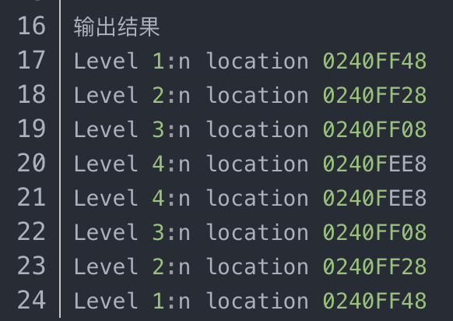

Slide 17
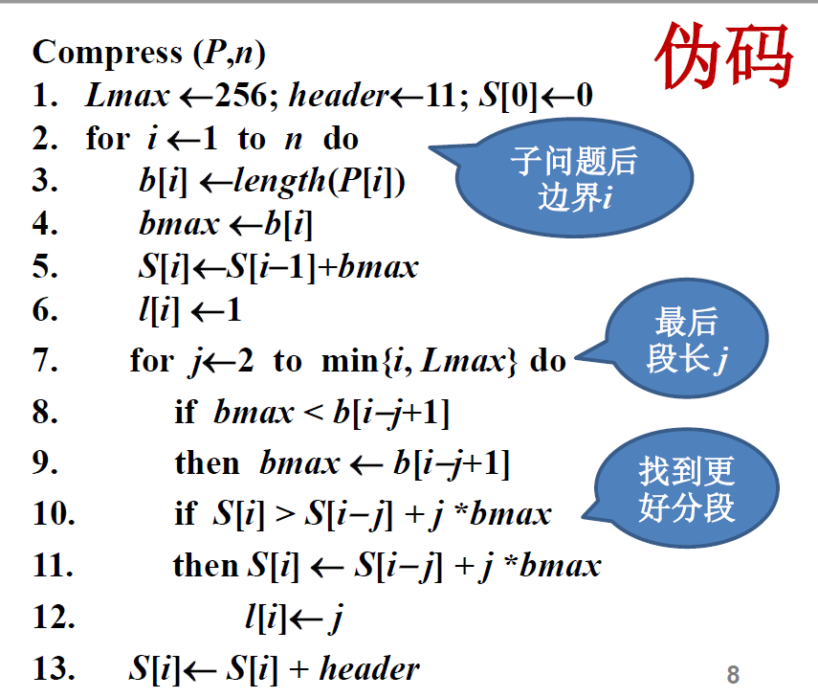
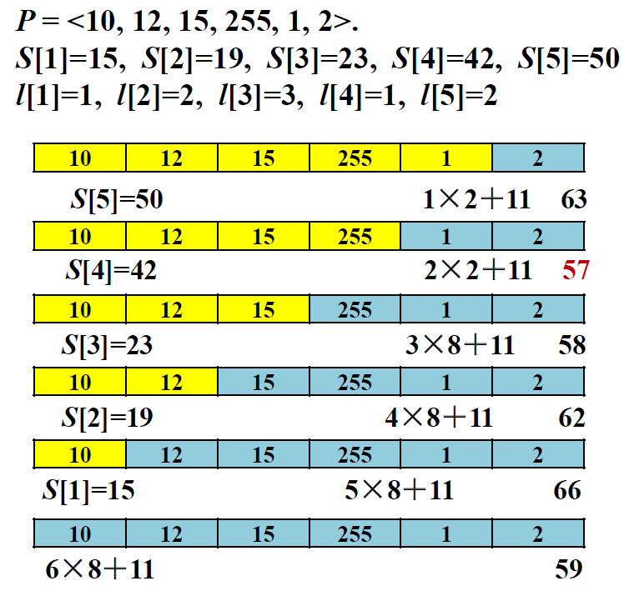

Slide 18
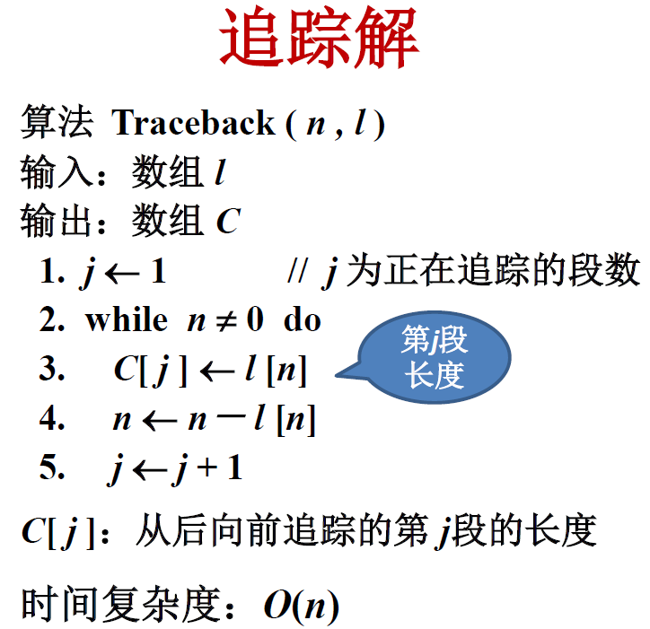
Ⅲ. construct the optimal solution

